Slide 1


MICROSOFT 365 VIRTUAL MARATHON Microsoft365DSC – The Next Best Thing Since Sliced Bread
Nik Charlebois
Senior Premier Field Engineer - Microsoft
@NikCharlebois
Brought to you by:
The Global Microsoft Community &
#M365VM
M365VirtualMarathon.com
M365Conf.com | #M365CONF

Slide 2

Mark Your Calendars:
March 23-25, 2021, MGM Grand Resort
Las Vegas, Nevada, USA
M365Conf.com
#M365CONF
The SharePoint Conference is now The Microsoft 365 Collaboration Conference
Brought to you by:
The Global Microsoft Community &
#M365VM
M365VirtualMarathon.com
M365Conf.com | #M365CONF

Slide 3














Thank you to all our generous sponsors

Slide 4


@NikCharlebois
Senior Premier Field Engineer – Microsoft
Ex-PowerShell MVP
Based out of Gatineau, Quebec
Blogger at https://NikCharlebois.com
Product Lead for Microsoft365DSC
Brought to you by:
The Global Microsoft Community &
#M365VM
M365VirtualMarathon.com
M365Conf.com | #M365CONF

Slide 5

ARE YOU READY FOR A RAFFLE? We are giving away 3 Oculus Quest All In One!
Visit the Vendors Booth, Sessions and Watch the Videos
Submit Your Answers to Enter the Raffle
You need at least 5 correct answers then submit for a chance to win one of 3
(One in each Americas, APAC, EMEA)
https://bit.ly/m365raffle

Slide 6

What is Microsoft365DSC?
@NikCharlebois

Slide 7


Automate
Report
Export
Monitor
Synchronize
Assess
@NikCharlebois

Slide 8

Community
100% Open-Source on GitHub;
All the documentation is on the website;
Worldwide team of dedicated engineers;
Looking for help:
Testing;
Development;
Suggestions, ideas, and feedback;
aka.ms/M365DSC
@NikCharlebois

Slide 9
Automate
@NikCharlebois

Slide 10
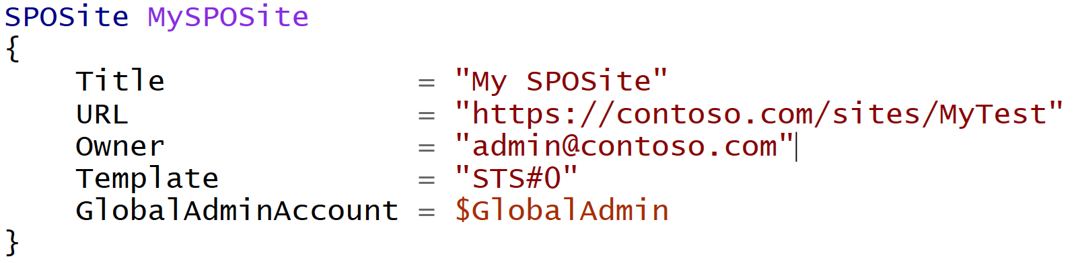
Difference with Classic PowerShell
It’s a Declarative approach;
@NikCharlebois
Notes:
Meaning I don’t tell it do this and then that, but rather here is how I want this, then do whatever in you need to to get me there

Slide 11
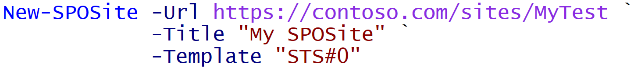
Difference with Classic PowerShell
Declarative:
Imperative:
@NikCharlebois
Notes:
Meaning I don’t tell it do this and then that, but rather here is how I want this, then do whatever you need to get me there

Slide 12

Automate – Deploy Configuration
Write your Microsoft 365 Configuration as Code
@NikCharlebois

Slide 13








Automate – Deploy Configuration
Automate the Configuration of all M365 Workloads
@NikCharlebois

Slide 14

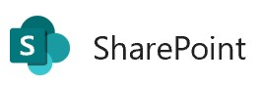



Logic Flow
Abstraction layer sitting on top of all underlying modules;
Allows you to write 1 configuration to handle all workloads;
Microsoft365DSC Configuration
SharePoint PnP
MicrosoftTeams
SkypeForBusinessAPI
Exchange Online Shell
…
Remote Calls
Security & Compliance
@NikCharlebois

Slide 15
IMPORTANT
M365DSC deals with Configuration and Structure, not data
*It could easily be extended to handle data;
Not supported with PowerShell Core since the underlying dependencies don’t support it;
@NikCharlebois

Slide 16
Demo 1
Automate
@NikCharlebois

Slide 17
Monitor
@NikCharlebois

Slide 18


Monitor – Continuously check for config drifts
Analyze for Drift
Act on detected drifts: Fix, Log or Alert
@NikCharlebois

Slide 19
Monitor Configuration Drifts
+Fix
+Monitor
Default Setting
ApplyOnly
ApplyAndMonitor
ApplyAndAutocorrect
Configure as specified, the done
Configure, and Log Configuration Drifts
Configure, Log & Fix Configuration Drifts
@NikCharlebois

Slide 20
Demo 2
Monitor
@NikCharlebois

Slide 21
Export
@NikCharlebois

Slide 22
Export – Get full fidelity config from existing tenant
Export
Full-Fidelity Configuration Export
Existing Microsoft 365 Environments
@NikCharlebois

Slide 23

Exposes the Export-M365DSCConfiguration cmdlet when M365DSC is installed;
Provides an interface to pick and choose components to extract;
Exports all configuration as a .ps1 configuration file;
Simply need to provide credentials of account with admin access to the selected workloads
@NikCharlebois

Slide 24
Demo 3
Export
@NikCharlebois

Slide 25
Report
@NikCharlebois

Slide 26


Report – Convert config to Excel or HTML
Export
Generate Reports
@NikCharlebois

Slide 27
Demo 4
Report
@NikCharlebois

Slide 28
Synchronize
@NikCharlebois

Slide 29
Synchronize – Keep multiple tenants’ config in Sync
Tenant A
Export
Automate
Tenant B
@NikCharlebois

Slide 30
Synchronize – Keep multiple tenants’ config in Sync
Tenant A
Tenant B
@NikCharlebois

Slide 31
Demo 5
Synchronize
@NikCharlebois

Slide 32
Assess
@NikCharlebois

Slide 33

Assess – Blueprints
Assess Existing Environments Against Known Good Configurations
M365DSC Blueprints
Discrepancy Report
@NikCharlebois

Slide 34

Assess – Different Tenants
Tenant A
Tenant B
Discrepancy Report
Export
Export
Generate
Compare
@NikCharlebois

Slide 35
Assess – Delta between 2 Point-in-Time Exports
April 2020
Export
April 2020
@NikCharlebois

Slide 36
Assess – Delta between 2 Point-in-Time Exports
May 2020
Export
April 2020
May 2020
@NikCharlebois

Slide 37
Assess – Delta between 2 Point-in-Time Exports
Discrepancy Report
Generate
April 2020
May 2020
Compare
@NikCharlebois

Slide 38
Demo 6
Assess
@NikCharlebois

Slide 39


THANK YOU FOR JOINING US!
THE SESSION WILL BEGIN SHORTLY
USE THE Q&A PANEL TO ASK ANY QUESTIONS?
Speaker feedback
https://bit.ly/M365VMSpeakerFeedback
Event feedback
https://bit.ly/M365VMFeedback

Slide 40





CONSIDER DONATING TO THE FOLLOWING CHARITY RELIEF FUNDS: UNITED WAY OR INTERNATIONAL MEDICAL CORPS
THANK YOU FOR JOINING US! 10% OF FUNDS FROM SPONSORS GO TO SUPPORT COMMUNITY RELIEF
United Way: https://give.uwkc.org/M365VM
International Medical Corps: https://bit.ly/MedicalCorpsFund

Slide 41
THANK YOU FOR JOINING US!
DO YOU HAVE ANY QUESTIONS?
[OPTIONAL: Let’s Connect: Social Media Links or Email]
Brought to you by:
The Global Microsoft Community &
#M365VM
M365VirtualMarathon.com
M365Conf.com | #M365CONF

